Slide 1
Math for CG
Linear Algebra

Slide 2
Outlines
Matrix
Vector
Linear Algebra
Linear Transformation

Slide 3
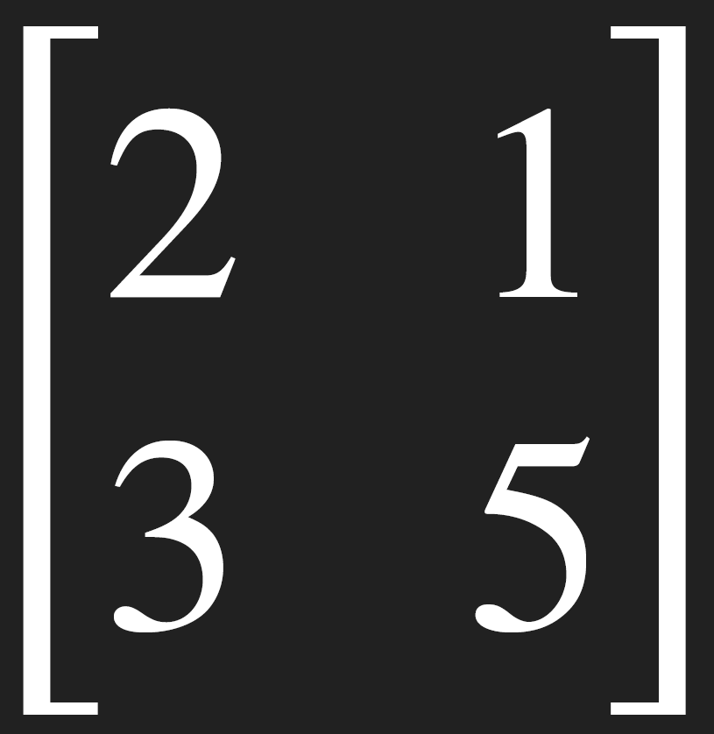
MATRIX
Column j
ª11 ª21 . . | ª12 ª22 . . | . . . | ª1j ª2j . . | . . . | ª1m ª2m . .
 |  | . . . . . . . . . |  | . . . . . . . . .
ªi1 | . | . . . | ªij | . . . | ªim
^{A}n×m ⁼
Row i
. . . . . . . . . .
. . . . . . . . . .
a_{n2} . . . n_{nj} . . . n_{nm}
ªn1

Slide 4
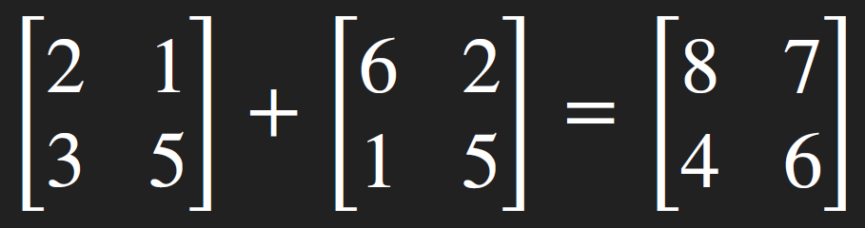
MATRIX ADDITION/SUBTRACTION
▸ Both matrix have the same shape (dimension)
Column j
element wise
^{b}11 ^{b}12
^{b}21 ^{b}22
. . .
. . .
^{b}1j ^{b}2j
. . .
. . .
^{b}1m ^{b}2m
ª11 ª21 . . | ª12 ª22 . . | . . . | ª1j ª2j . . | . . . | ª1m ª2m . .
 |  | . . . . . . . . . |  | . . . . . . . . .
ªi1 | . | . . . | ªij | . . . | ªim
. ªn1 | . ªn2 | . . . . . . | . ^{n}nj | . . . . . . | . ^{n}nm
. . . . .
. . . .
.
^{A}n×m ⁼
^{B}n×m ⁼
. . . . . .
b_{i1} . . . . b_{ij}
. . . .
. . . b_{im}
Row I
. . . . . . . . . .
. . . . . .
. . . .
. . . . . .
b_{n1} b_{n2} . . . b_{nj}
. . . .
. . . b_{nm}
^{C}n×m ^{= A}n×m ^{+ B}n×m
^{C}ij ^{= a}ij ^{+ b}ij
^{C}n×m ^{= A}n×m ^{− B}n×m
^{C}ij ^{= a}ij ^{− b}ij
3
10

Slide 5
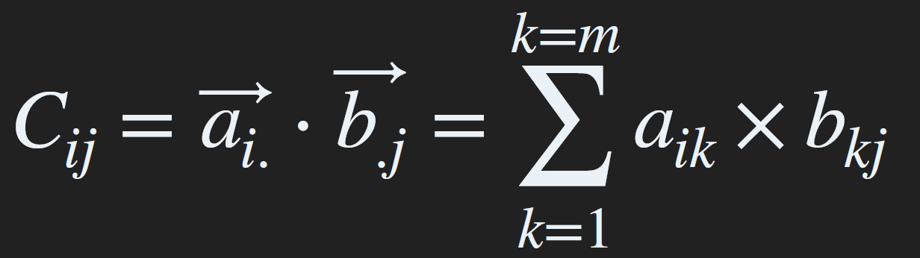
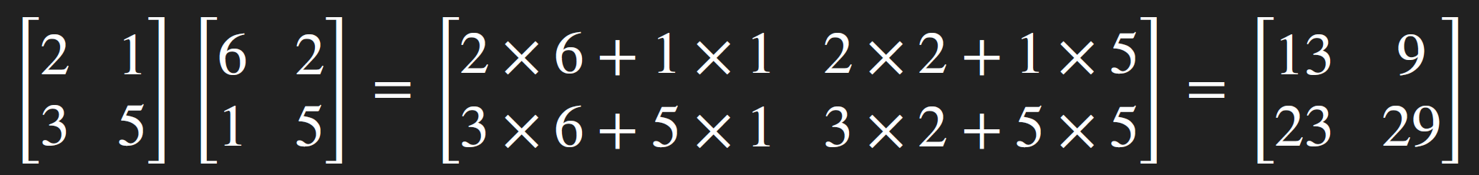
MATRIX MULTIPLICATION
▸ Matrix
Column j
^{b}11 ^{b}12
^{b}21 ^{b}22
. . .
. . .
^{b}1j ^{b}2j
. . .
. . .
^{b}1p ^{b}2p
ª11 ª21 . . | ª12 ª22 . . | . . . | ª1j ª2j . . | . . . | ª1m ª2m . .
 |  | . . . . . . . . . |  | . . . . . . . . .
ªi1 | . | . . . | ªij | . . . | ªim
. ªn1 | . ªn2 | . . . . . . | . ^{n}nj | . . . . . . | . ^{n}nm
.
. . . .
. . . .
.
.
^{b}i1
. . . . .
. . . . b_{ij}
. . . .
. . . b_{ip}
^{A}n×m ⁼
Row I
^{B}m×p ⁼
. . . . . . . . . .
.
. . . . .
. . . .
.
^{b}m1
. . . . .
b_{m2} . . . b_{mj}
. . . .
. . . b_{mp}
Matrix Multiplication: Product
C = A B
n×p n×m m×p

Slide 6
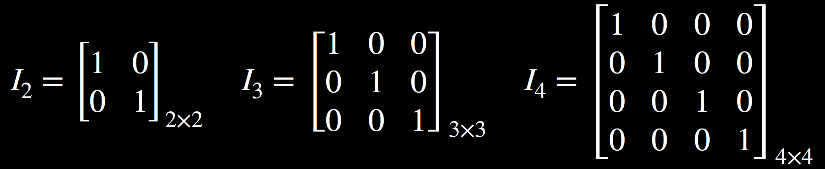
Identity Matrix
A × I = I × A = A

Slide 7
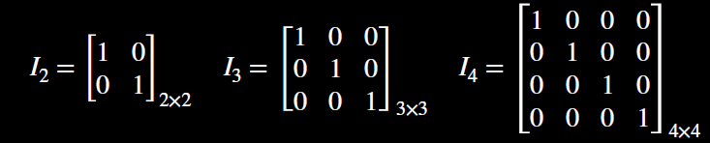
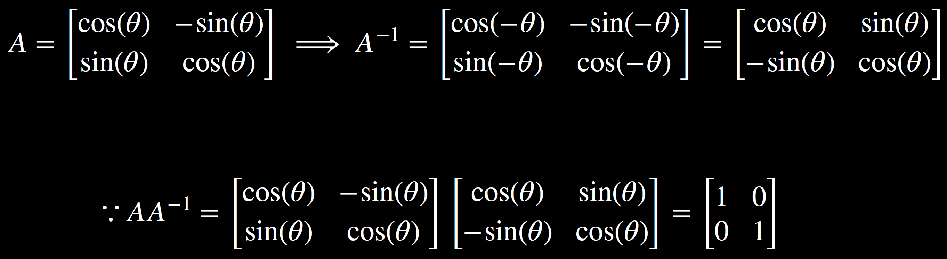
Inverse Matrix
AA⁻¹ = A⁻¹A = I
A must be square and det(A) ≠ 0

Slide 8
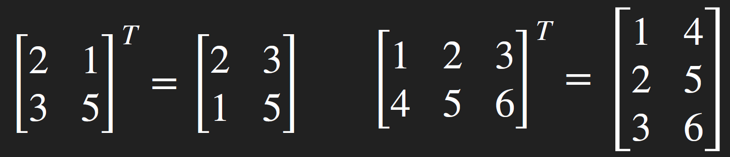
TRANSPOSE
rotate 90º
Column j
ª11 ª21 . . | ª12 ª22 . . | . . . | ª1j ª2j . . | . . . | ª1m ª2m . .
 |  | . . . . . . . . . |  | . . . . . . . . .
ªi1 | . | . . . | ªij | . . . | ªim
. ªn1 | . ªn2 | . . . . . . | . ^{n}nj | . . . . . . | . ^{n}nm
element wise
ª11 ª21
. . .
. . .
ªi1
. . .
. . .
ªn1
ª12 ª22
ªi2
ªn2
. . . . . . . . .
.
C =
. . . . . .
a_{j1} . . . . a_{ji}
ª1n ^{n}im
. . . .
. . . a_{nj}
^{n}nm
A =
n×m
Row I
. . . . . .
. . . .
. . . . . . . . . .
. . . . . .
a_{2n} . . .
. . . .
. . .
T T
(A ) = A
C = A^{T} ⟺ C_{ij} = A_{ji}
(AB)^{T} = B^{T} A^{T}

Slide 9
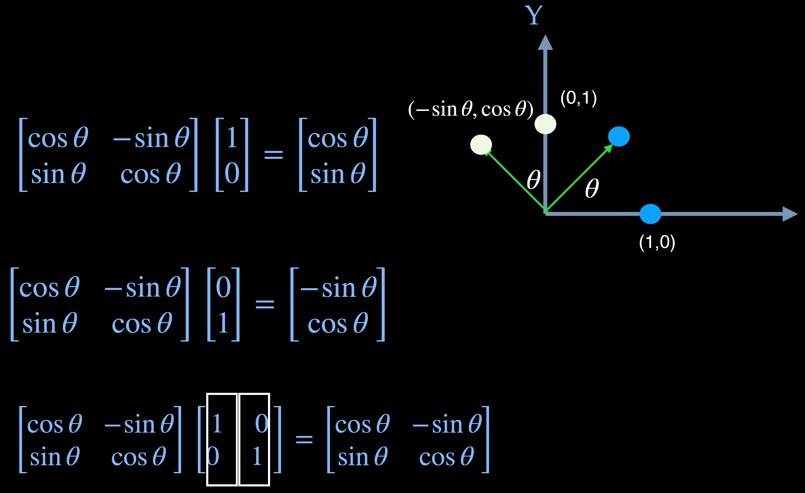
Transformation

Slide 10


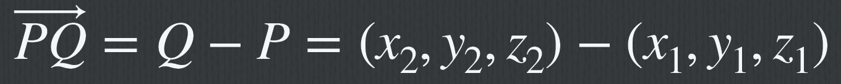
Vectors
A vector is a quantity with two attributes Direction
Magnitude Examples include
Force Velocity
Q = (x₂, y₂, z₂)
v
P = (x₁, y₁, z₁)

Slide 11
Vector Length
Vector a =( x_{a}, y_{a} )
The length of vector a is computed as follow. ∥a∥ = x² + y²
a a
||a||
y_{a}
a
ifv = (x, y, z) then
∥v∥ =
x² + y² + z²
x_{a}

Slide 12
Vector Operations
v
Every vector has an inverse
Same magnitude but points in opposite direction
-v
αv
v
w
Every vector can be multiplied by a scalar
u

Slide 13

Vector Operations
V + W = (x₁, y₁) + (x₂, y₂) = (x₁ + x₂, y₁ + y₂)
V − W = (x₁, y₁) − (x₂, y₂) = (x₁ − x₂, y₁ − y₂)
αV = α(x, y) = (αx, αy)
13

Slide 14
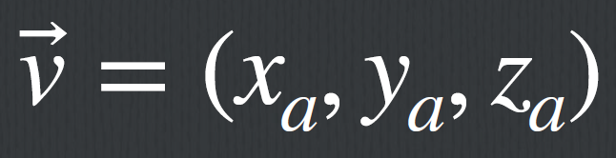
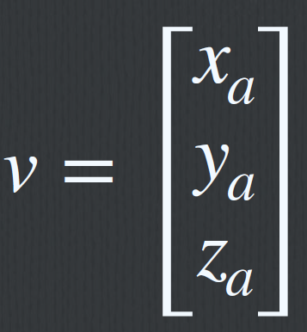
Vector Transposition
A vector v⃗ = (x_{a}, y_{a}, z_{a})
Given a vector(column)
express as matrix form
x_{a}
v =
y_{a}
^{z}a
The transpose of vector v
v^{T} = [xa
y_{a} z_{a}]

Slide 15

Vector Space 向量空間
由ㄧ組線性獨立（linear independent) 的向量稱為基底 {v₁, v₂, …, v_{n}}所構成
可經由向量加法(vector addition)與純量乘法(Scale multiplication)所擴展⽽成的線性空間
α₂v₂
v = α₁v₁ + α₂v₂
α v + α v
v
1 1 2 2
2
v₁ α₁v₁
15

Slide 16
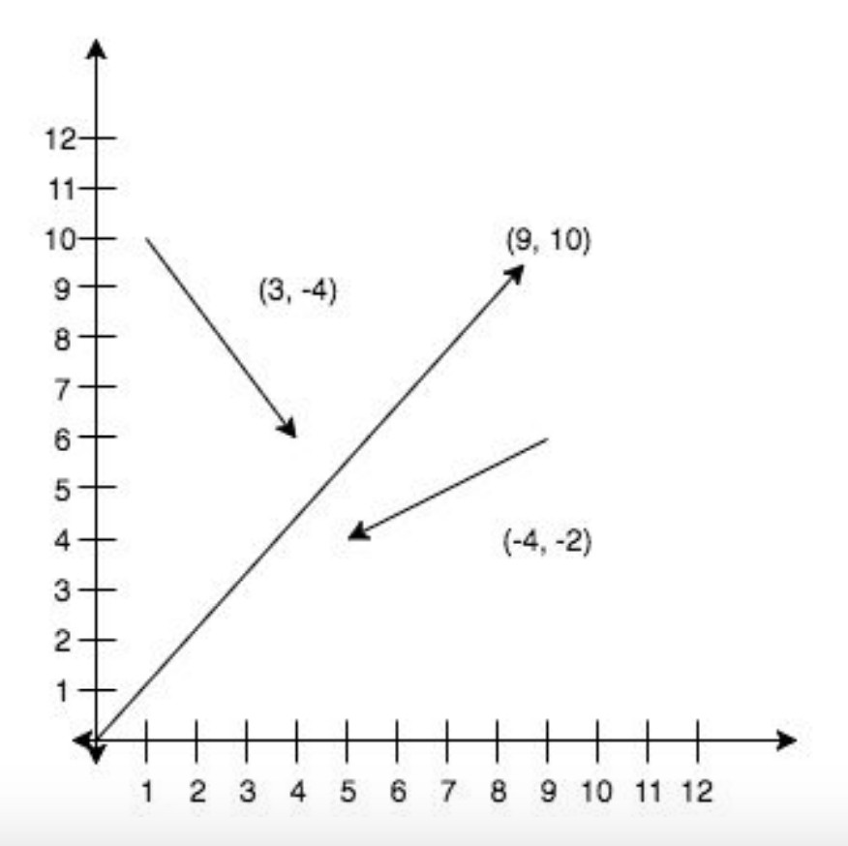
n-D Vector Space 向量空間
v₁ v₂
v⃗ = c₁v₁ + c₂v₂ + … + c_{n}v_{n} = [c₁, c₂, …, c_{n}]
.
.
.
^{v}n
16

Slide 17

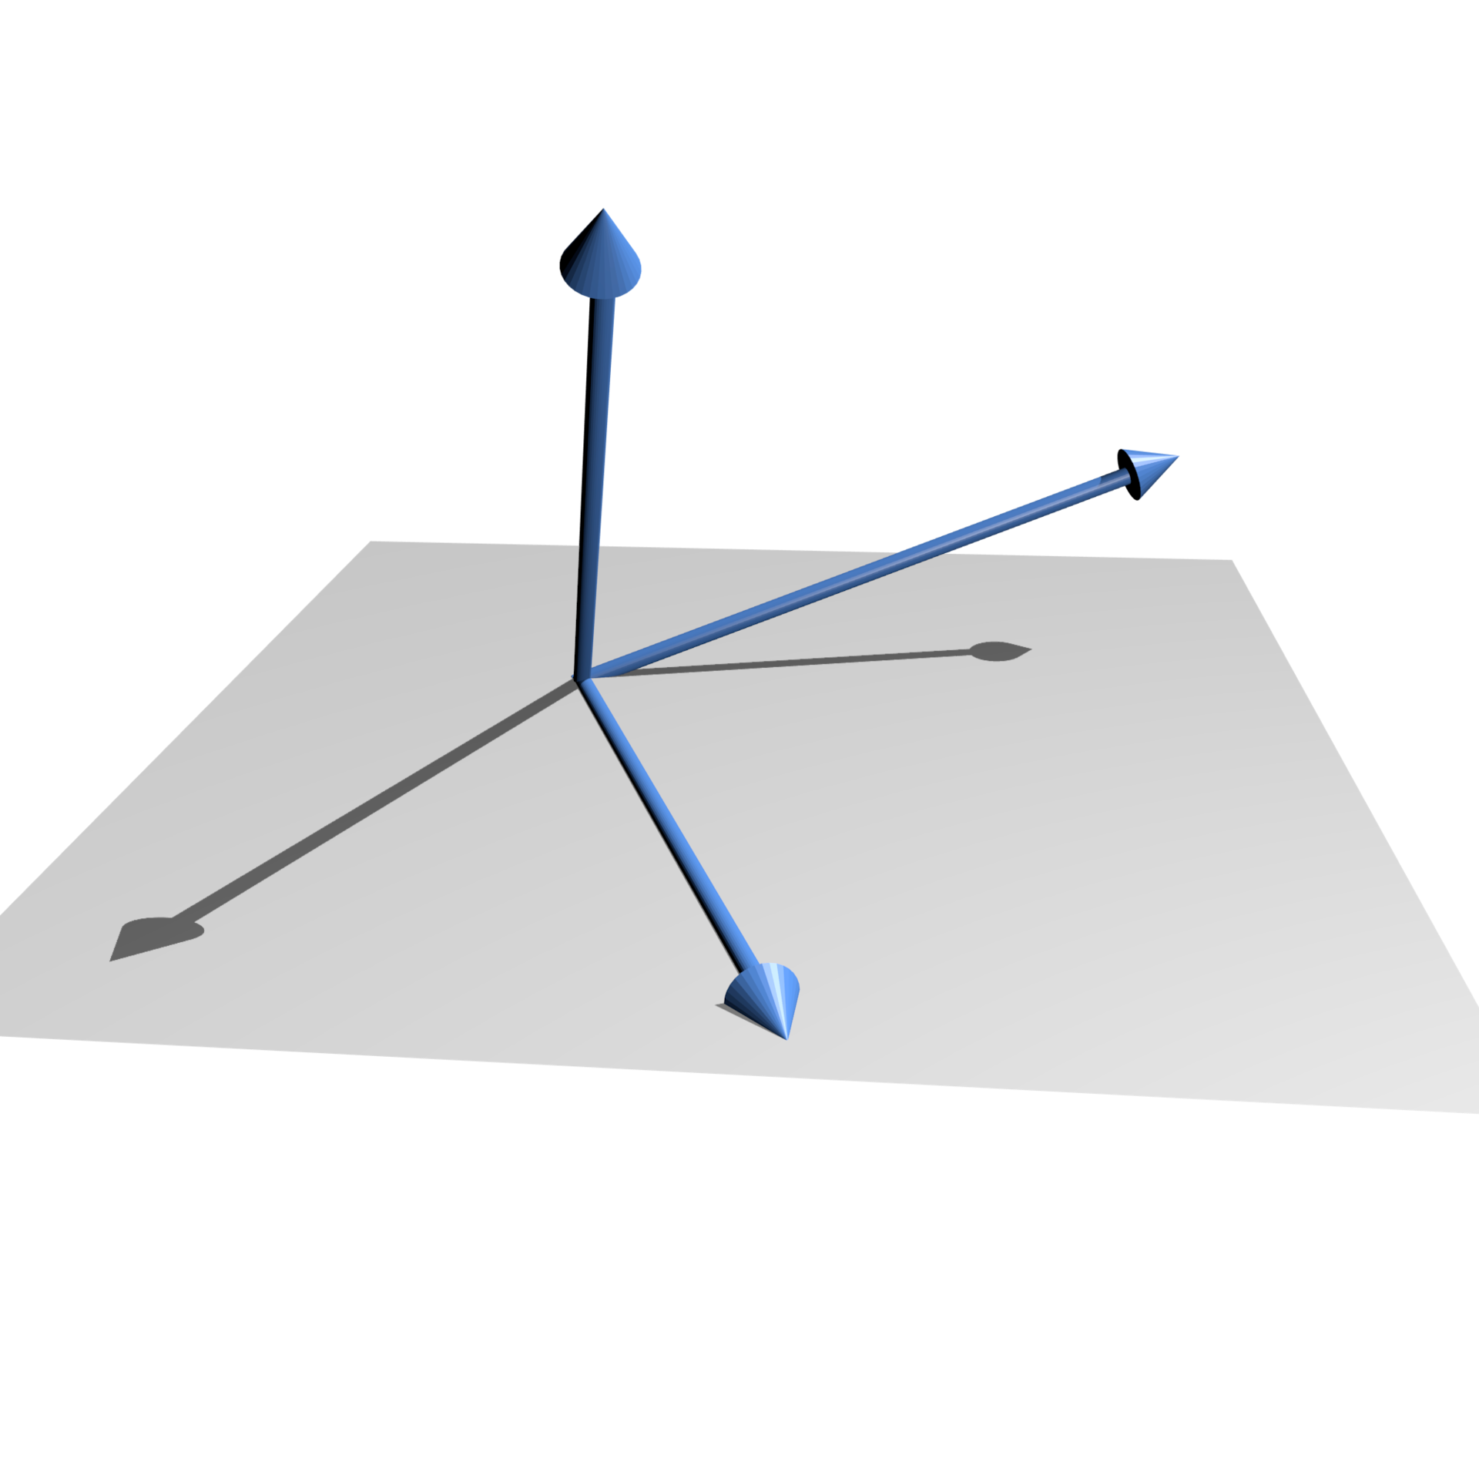
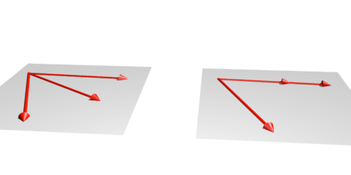
Linear Independence 線性獨⽴
A set of vectors v₁, v₂, …, v_{n} is linearly independent if
α₁v₁+α₂v₂+.. α_{n}v_{n}=0 iff α₁=α₂=…=0
Linearly dependent vectors in a plane in R³.
17

Slide 18
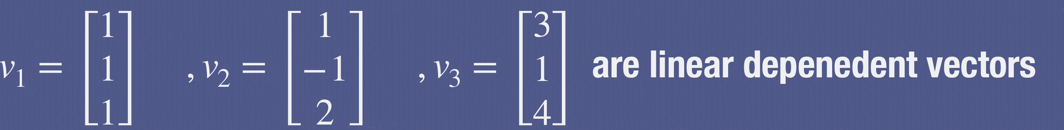
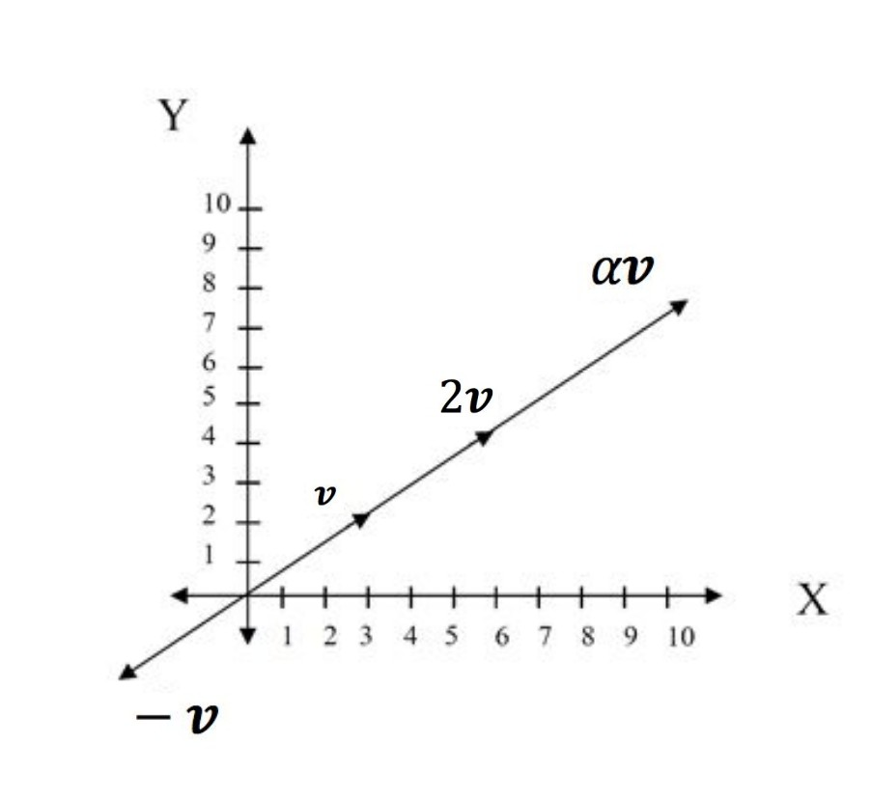
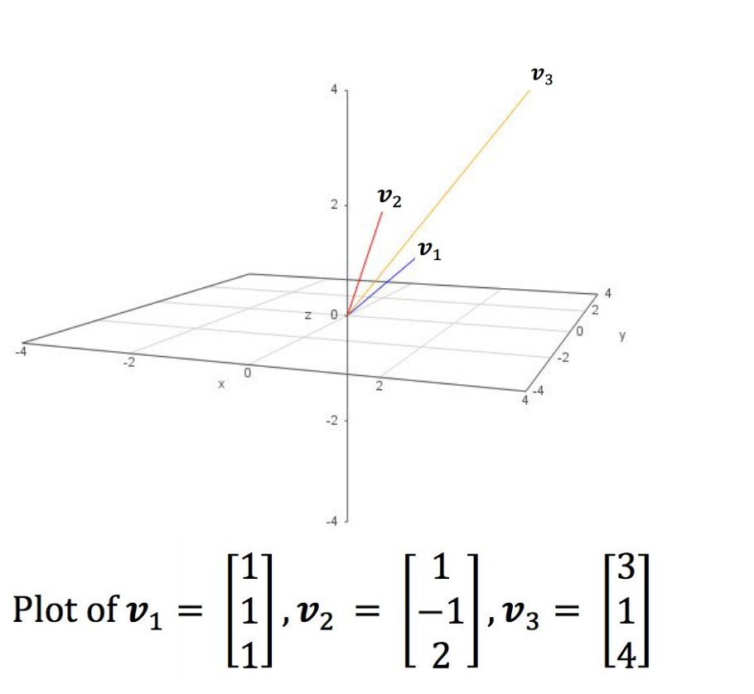
Linear dependent
If a set of vectors is linearly dependent, at least one can be written in terms of the others
Vector (3,6) and (1,2) are linear dependent
18

Slide 19
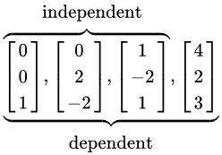

Linear independent
19

Slide 20
Dimension
在向量空間(vector space)中，線性獨立向量 (linearly independent vectors) 的最⼤數量是固定的，稱為空間維數(Dimension)
在n維空間中，n個線性獨立向量的任意集合構成該空間的基礎
Given a basis v₁, v₂,…., v_{n}, any vector v can be written as
v=α₁v₁+ α₂v₂ +….+α_{n}v_{n}
(α₁, α₂, …, α_{n}) is the presentation of v in this vector space
20

Slide 21
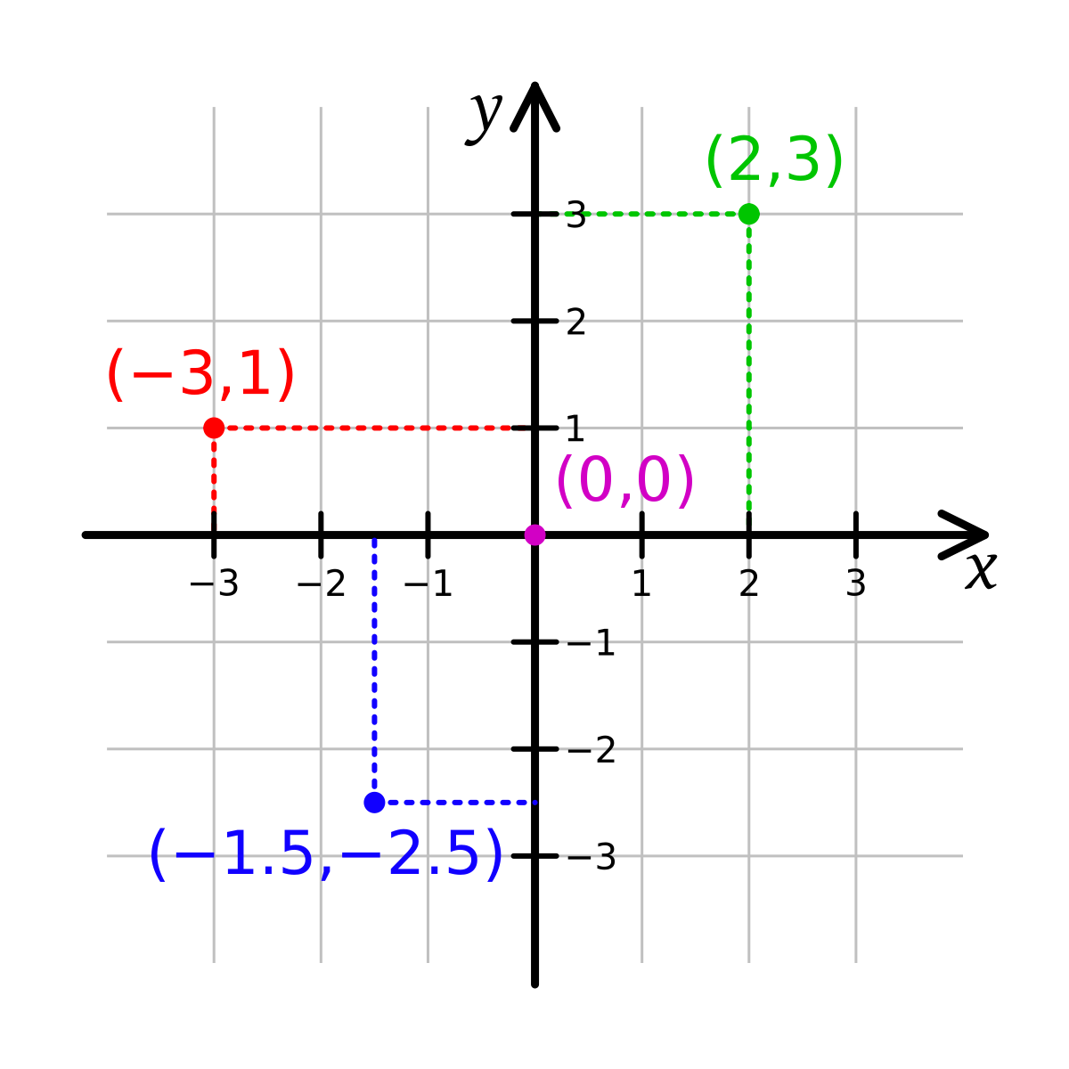
2D Vector Space 向量空間
The basis {e₁, e₂}
vector
(2,3) = 2(1,0) + 3(0,1)
21

Slide 22
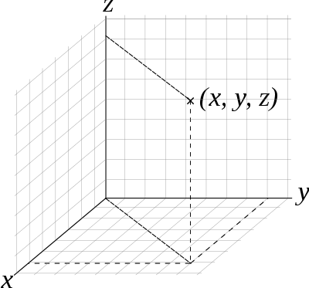
3D Vector Space 向量空間
The basis {e₁, e₂, e₃}
vector (x, y, z) = x(1,0,0) + y(0,1,0) + z(0,0,1)
e₂
e₃
e₁
22

Slide 23
笛卡兒座標系 (Cartesian coordinate system)
直角坐標系。
The basis {e₁, e₂}
The Origin O = (0,0)
The basis {e₁, e₂, e₃}
The Origin O=(0,0,0)
vector (x, y, z) = x(1,0,0) + y(0,1,0) + z(0,0,1)
vector
(2,3) = 2(1,0) + 3(0,1)
23

Slide 24
2D笛卡兒座標系 (Cartesian coordinate system)
在平⾯上笛卡兒坐標為(x₁, y₁)和(x₂, y₂) 的兩個點之間的歐幾⾥得距離是：
d = (x₂ − x₁)² + (y₂ − y₁)²
在3D笛卡兒坐標為(x₁, y₁, z₁)和(x₂, y₂, z₂) 的兩個點之間的歐幾⾥得距離是：
d = (x₂ − x₁)² + (y₂ − y₁)² + (z₂ − z₁)²
24

Slide 25
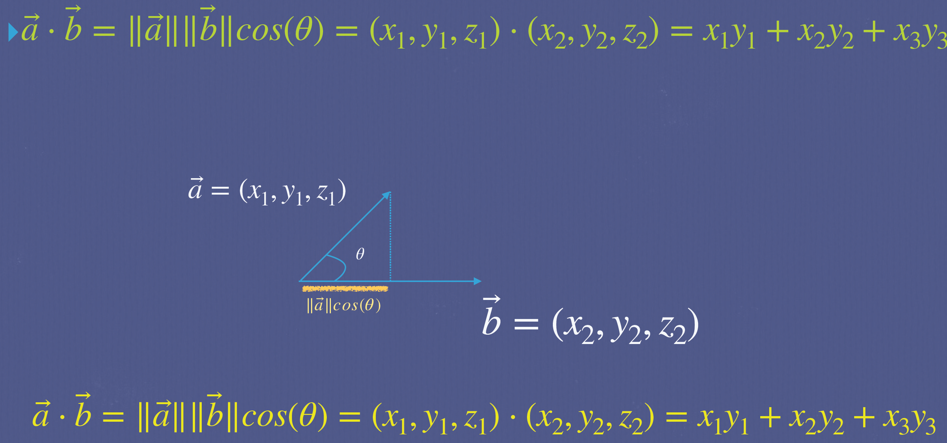
VECTOR INNER PRODUCT (DOT PRODUCT)

Slide 26
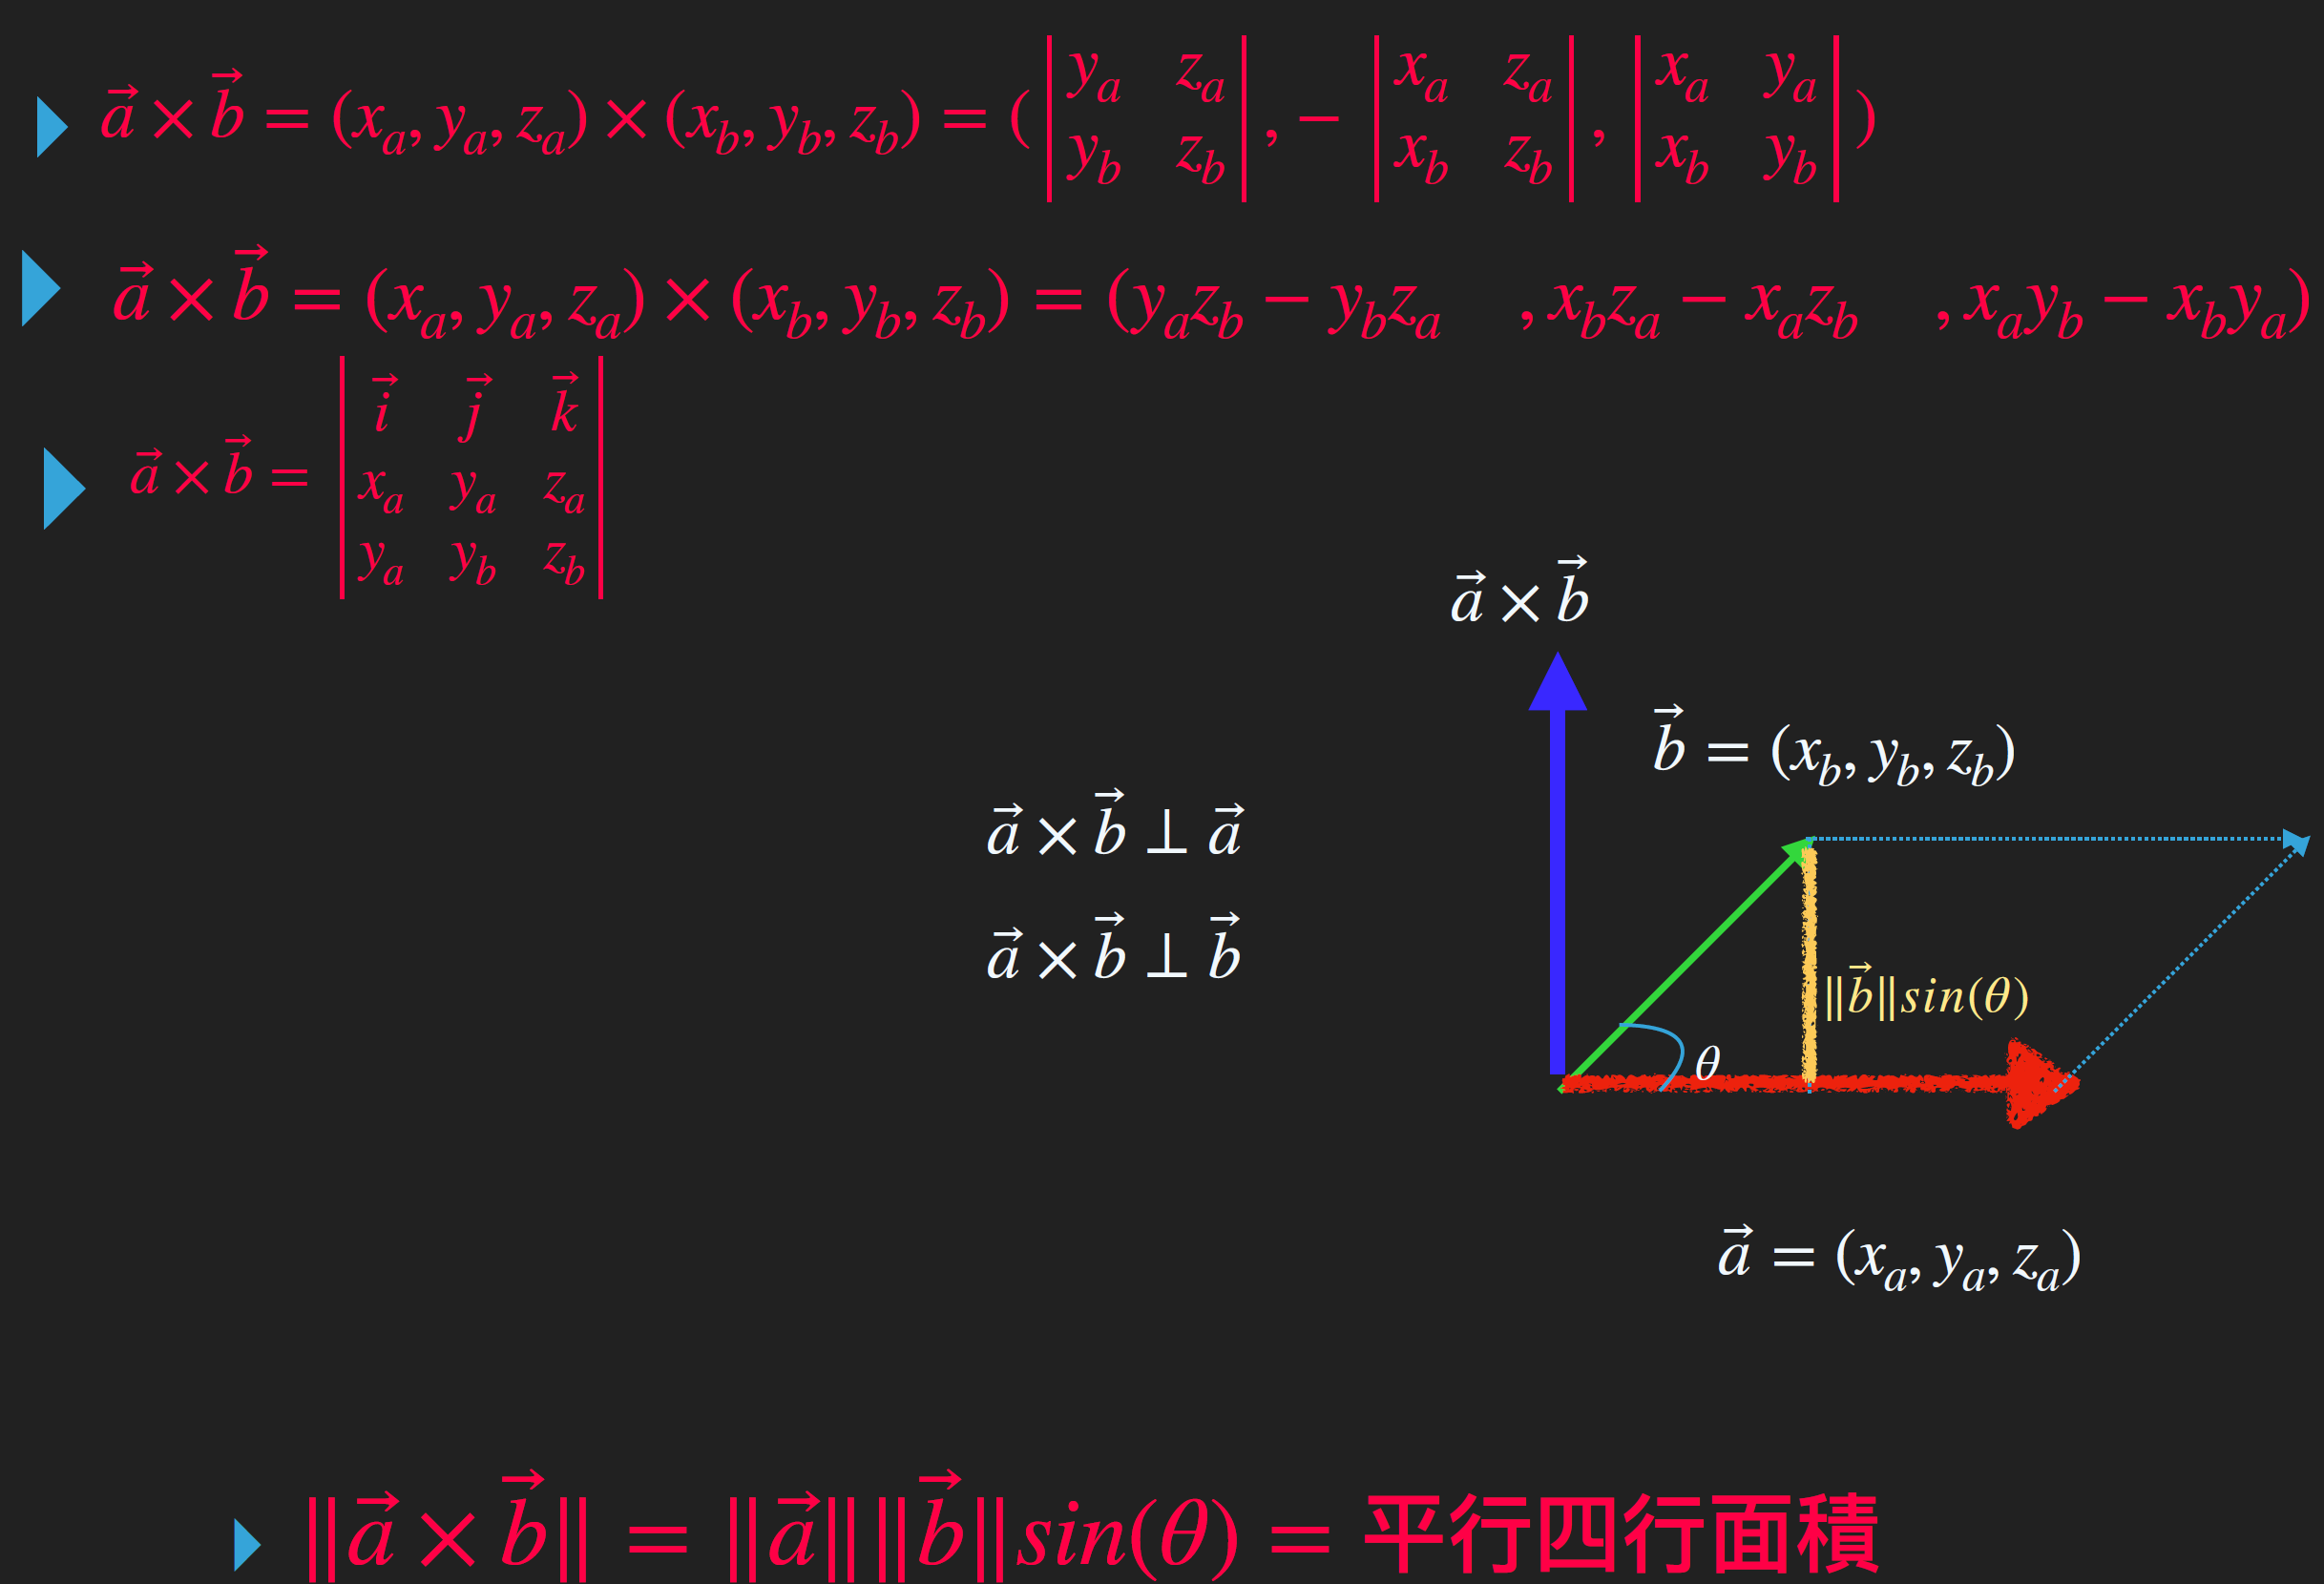
VECTOR CROSS PRODUCT

Slide 27
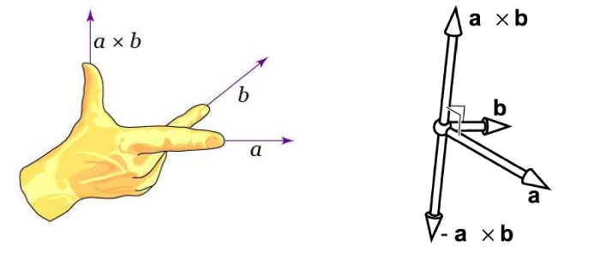
Right Hand Rule

Slide 28
Examples
i ⃗ j ⃗ k
⃗ _{ya}
⃗
z_{a}
x_{a} z_{a} x_{a} y_{a}
x z x y
▸ a⃗ × b⃗ =
x_{a} y_{a} z_{a}
▸ a⃗ × b = (x_{a}, y_{a}, z_{a}) × (x_{b}, y_{b}, z_{b}) = ( _{y}
z
, −
,
)
y_{a} y_{b} z_{b}
b b
b b
b b

